Slide 1

Software Engineering Presentation On Refactoring HtmSerializer Presented by
Khaled Kandil
Erdi Tras

Slide 2
HTMSerializer
Introduction
Serialize
Deserialize
Refactoring
UnitTests
Methods

Slide 3
Introduction
What is the HtmSerializer?
Purpose of the Serialization and Deserialization
What is the Unit Tests and Refactoring?
Objective of our task
Notes:
Our project is Refactoring HtmSerializer.
Our project have 4 main step; Let us explain these steps in more detail.
Firstly, What is HTM? What does it do? A Hierarchical Temporal Memory (HTM) serializer is a software component that is designed to convert HTM objects into a serialized format.
HTM is a machine learning algorithm that is based on principles of neuroscience and is designed to recognize patterns in data streams, such as those found in sensor data or natural language.
- We have the important part of our project. The purpose of serialization is to convert an object's state to a format that can be stored or transmitted over a network, and then later restored to its original state using a process called deserialization. Deserialization is opposite of the serialization. Also have some methods to serializing.
- Other important part of our project is Unit Tests and Refactoring. HTM serialization unit tests are an important part of the software development process. Help to ensure that the serializer works correctly and is free of bugs or errors.
Sometimes some unit tests related to our project may give errors when we debug. We are also making some changes in the source code to eliminate these errors.
-Refactoring a Hierarchical Temporal Memory (HTM) serializer would involve making improvements to the design of the serializer without changing its overall purpose. This can be particularly important in the field of machine learning.
- Our task is refactoring the code of the HTMSerializer File with using all Unit Tests (HtmSerializationTests). This means making the code more legible and understandable. In order to do that, we are going to separate the methods that use serialize and deserialize in two classes.

Slide 4
Methods
→Two methods named Serialize() and Deserialize have been implemented under NeoCortexApi directory in HTM and they are the two main methods of our project. This Seralize function creates an instance of the HtmSerializer class and initiates functions called SerializeBegin and SerializeEnd.
→The methods Serialize Begin and Serialize End are both formatting methods and indicate the start and end respectively of the serialize object.
→ The Serialize method is used to serialize an object to a string, and the Deserialize method is used to deserialize a string to an object.
→Here’s the some main refactored methods for Serialization Part. The interface contains the following methods:
Readbegin, ReadGenericBegin, ReadEnd, ReadGenericEnd, SerializeBegin, SerializeEnd..
→ Class is used to serialize and deserialize various data types, such as primitive types, dictionaries, lists, and custom objects. The class provides methods for serializing and deserializing values of different types, such as int, double, string, long, bool, and arrays. It also provides methods for serializing and deserializing custom objects, such as Synapse, DistalDendrite, Cell, and dictionaries with custom keys and values. The class also includes a method for checking if two objects are equal.
Notes:
Two methods named Serialize() and Deserialize have been implemented under NeoCortexApi directory in HTM and they are the two main methods of our project. This Seralize function creates an instance of the HtmSerializer class and initiates functions called SerializeBegin and SerializeEnd.
The methods Serialize Begin and Serialize End are both formatting methods and indicate the start and end respectively of the serialize object.
The Serialize method is used to serialize an object to a string, and the Deserialize method is used to deserialize a string to an object. The SerializeValue method is used to serialize a single value, and the DeserializeValue method is used to deserialize a single value.
Here’s the some main refactored methods for Serialization Part. The interface contains the following methods:
Readbegin, ReadGenericbegin, ReadEnd, ReadGenericEnd, Serializebegin, SerializeEnd,..
Regarding the kind of serialization, Our Code uses custom serialization for serializing and deserializing objects. It does not use any built-in serialization frameworks like JSON.NET or XML Serialization.
The custom serialization is implemented using the StreamWriter and StreamReader classes to write and read data to and from a file or a string.
The serialization process involves writing the object's properties and values to a string using a custom delimiter to separate them. The deserialization process involves reading the string, splitting it using the custom delimiter, and then recreating the object with the same properties and values
The custom serialization in the code provided uses the following techniques:
Delimited Serialization: The properties and values of an object are serialized as a string with custom delimiters to separate them.
Nested Serialization: Objects that contain other objects as properties are serialized recursively.
Custom Serialization: The serialization process is customized to handle specific types of objects, such as dictionaries and arrays.
The code provided uses the following classes for serialization:
StreamWriter and StreamReader: These classes are used to write and read data to and from a file or a string.
SerializeValue and DeserializeValue: These methods are used to serialize and deserialize the properties and values of an object.
SerializeObject and DeserializeObject: These methods are used to serialize and deserialize entire objects, including their properties and values.
SerializeDictionary and DeserializeDictionary: These methods are used to serialize and deserialize dictionaries.
SerializeArray and DeserializeArray: These methods are used to serialize and deserialize arrays.
The custom serialization used in the code provided is less flexible than built-in serialization frameworks like JSON.NET or XML Serialization.
However, it provides more control over the serialization process and can be optimized for specific use cases.
The class also includes some helper methods for checking if a type is a dictionary, list, or set, and for getting the specified type or default type from a header. So the class also include other methods such as for serializing and deserializing a Cell object, synapse object, distaldendrite object, dictionary object, list object and more different…

Slide 5
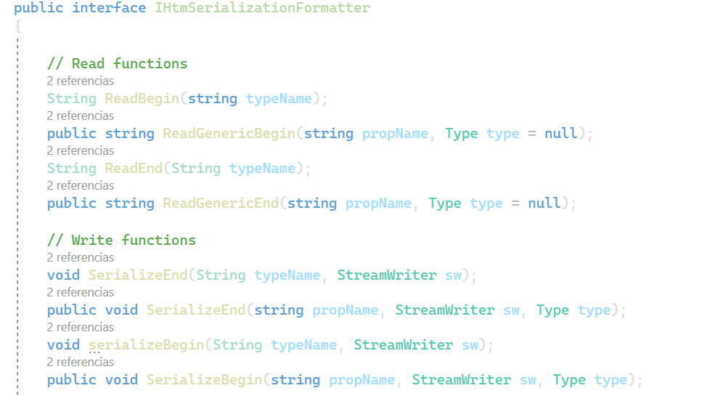
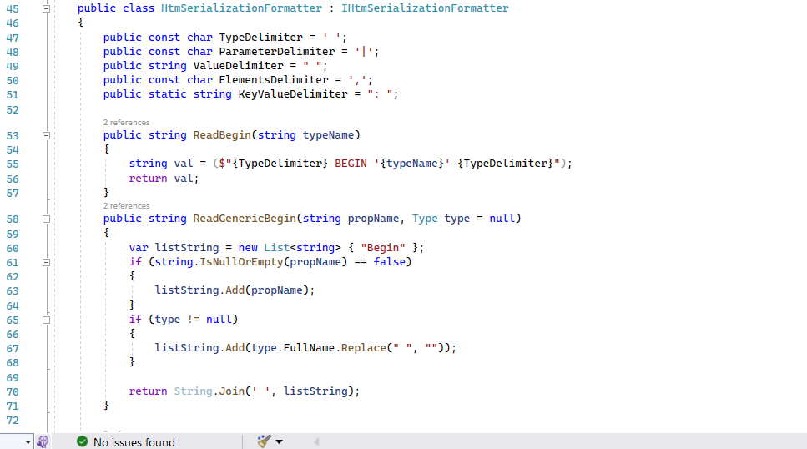
Refactoring & Unit Tests
Refactoring: is the process of improving the structure and design of existing code without changing its external behavior. It has two main steps;
1) Firstly, create an interface HtmSerializationFormatter that contains all formatting methods.
2) create the class HtmDefaultTextFormatter that implements all formatting methods.
Figure 1: Create the interface for refactoring
Figure 2: Create the class for refactoring
Notes:
Refactoring: Refactoring a Hierarchical Temporal Memory (HTM) serializer would involve making improvements to the design, structure, or functionality of the serializer without changing its overall purpose. Refactoring is typically done to improve the code's maintainability, extensibility, and readability, and to reduce technical debt.
The goal of refactoring is to make the code easier to understand and modify while preserving its functionality. Our task is refactoring the code of the HTMSerializer File. This means making the code more legible and understandable. It is the process of improving the structure and design of existing code without changing its external behavior. It has two main steps;
1) Firstly, create an interface HtmSerializationFormatter that contains all formatting methods.
2) create the class HtmDefaultTextFormatter that implements all formatting methods.
The HtmDefaultTextFormatter class is an implementation of the IHtmSerializationFormatter interface, which is used for serializing and deserializing objects to and from HTML-formatted text. The HtmDefaultTextFormatter class provides a default implementation of the IHtmSerializationFormatter interface.
The HtmSerializer class is a utility class for serializing and deserializing objects to and from HTML-formatted text. It uses an IHtmSerializationFormatter implementation to perform the serialization and deserialization. The HtmSerializer class provides methods for serializing and deserializing objects, as well as methods for serializing and deserializing individual values.
Default implementation of the `IHtmSerializationFormatter` interface for serializing and deserializing objects to and from HTML-formatted text.
Unit testing, an important aspect of software testing, entails inspecting individual units or components of a software system individually to ensure their intended functionality. The overall goal of this refactoring work is to improve the quality, efficiency, and maintainability of C# code bases. Using unit tests and serialization-deserialization methods, the project creates a solid and tested codebase that is both understandable and adaptive over time.
In conclusion, refactoring the HTMSerialization code was a worthwhile exercise that resulted in significant improvements to the codebase. It has made the code more maintainable, extensible, and testable, making it easier to work with and reducing the likelihood of introducing new bugs. Refactoring should be an ongoing process, and we should always strive to improve the quality of our code to ensure that it remains robust and easy to work with.

Slide 6


